Slide 1

Progress Presentation
30-01-2025
Prepared by: Marie Joe Sawma To: Dr. Reed Maxwell

Slide 2
Objective
Run Amanda's workflow for her test problem: finding the true Manning's value, using the Baseline simulation's Manning's as the true value.

Slide 3
Summary :
Run the Baseline Simulation: Execute `setup_experiment.py` to generate the Baseline simulation, which serves as the true value for Simulation-Based Inference (SBI) . It is also used to generate the prior distribution which is assumed to be uniform for the first run of SBI.
Generate the Ensemble: Create an ensemble from the prior/posterior distribution, getting a CSV file with 100 rows, each containing a different Manning’s value.
Run Simulations on ParFlow: Use ParFlow to simulate data for each Manning’s value from the ensemble created.
Train the SBI Model: Train the SBI model using the simulated data and the prior distribution to obtain the posterior distribution, representing the conditional probability of the parameter given the observed data.

Slide 4
Coding Part

Slide 5
SBI Environment
hf_hydrodata>=1.0.8 rioxarray>=0.13.4 rasterio>=1.3.9
subsettools>=1.0.3 jupyter>=1.0.0 ipykernel>=5.3.2
scikit-learn>=1.4.0 pytest-mock>=3.12.0. pytest>=8.0.0
pyshp>=2.3.1 pylint>=3.0.3 Pillow>=10.2.0
pftools>=1.3.10 pandas>=2.2.0 matplotlib>=3.8.2
black>=24.1.1 geopandas>=0.14.2 seaborn>=0.13.2
openpyxl>=3.1.5 s3fs>=2024.6.1
conda install -c conda-forge python=3.10 pip
conda install pytorch pytorch-cuda=12.4 -c pytorch -c nvidia

Slide 6
Modifications made for `settings . json `file
The HUC number in `new_press.JSON` file and `settings.json` are not the same. I changed the HUC that is in `settings.json` to be `02070001`the same as the `new_press.JSON` file
The `init_press_path` is generated from the outputs of the Baseline run in `setup_experiment.py`, and hence it could not be in the `settings.json` file that is used to run the baseline
The `observation path` is generated from the outputs of the Baseline run in `setup_experiment.py`, and hence it could not be in the `settings.json file which is responsible to run the baseline

Slide 7
Modifications made for `new_press.json`file
The `init_press_path` is generated from the outputs of the Baseline run in `setup_experiment.py`, and hence it cannot be in the `settings.json` file that is used to run the baseline
The `observation_path` is produced from the outputs of the Baseline run in setup_experiment.py and, as a result, cannot be included in the settings.json file, which is responsible for running the baseline.
The only difference between `new_press.json` and `settings.json` files is that the Baseline run spans one full water year in `new_press.json`. This Baseline simulation is used only in `analysis in ensemble.ipynb` file and it is unrelated to the creation of the ensemble or training of the model.

Slide 8
Modifications made for `setup_experiment.sh`file
module purge
module load anaconda3/2021.11
conda activate sbi_new

Slide 9
Modifications made for `create_ensemble.py`
create shell script for `create_ensemble.py`
adding sys library in `create_ensemble.py`
use a function from the imported library to read the json path instead of writing explicitly in `create_ensemble.py`

Slide 10
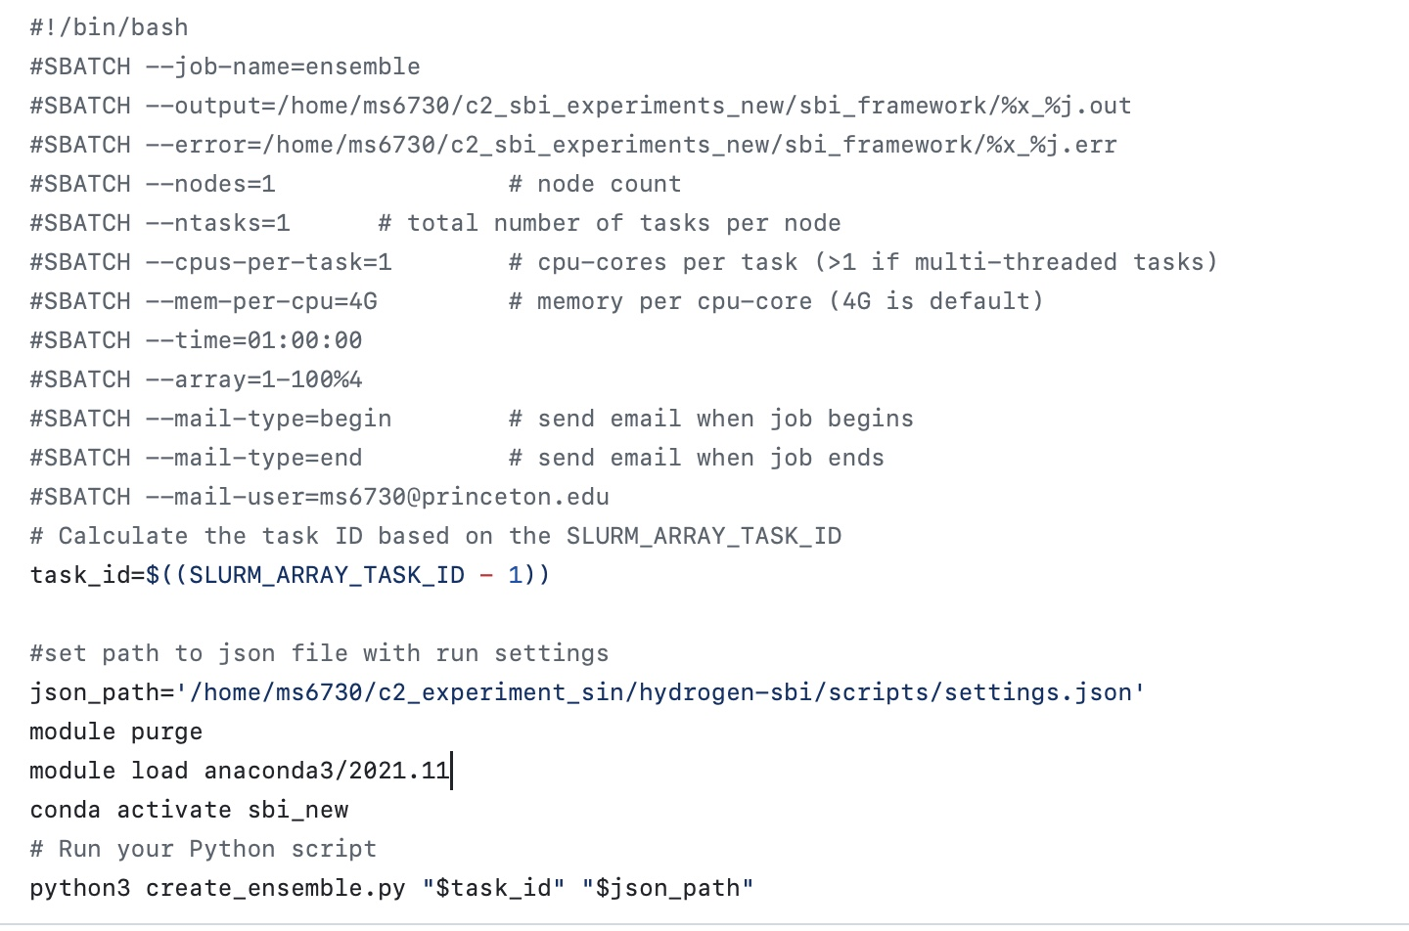
`create_ensemble.sh`

Slide 11
Modifications made for `create_ensemble.py`
create shell script for `create_ensemble.py`
adding `sys` library in `create_ensemble.py`
use a function from the imported library to read the json path instead of writing explicitly in `create_ensemble.py`

Slide 12
Modifications made for `run_ensemble.sh`
module purge
module load anaconda3/2021.11
conda activate sbi_new

Slide 13
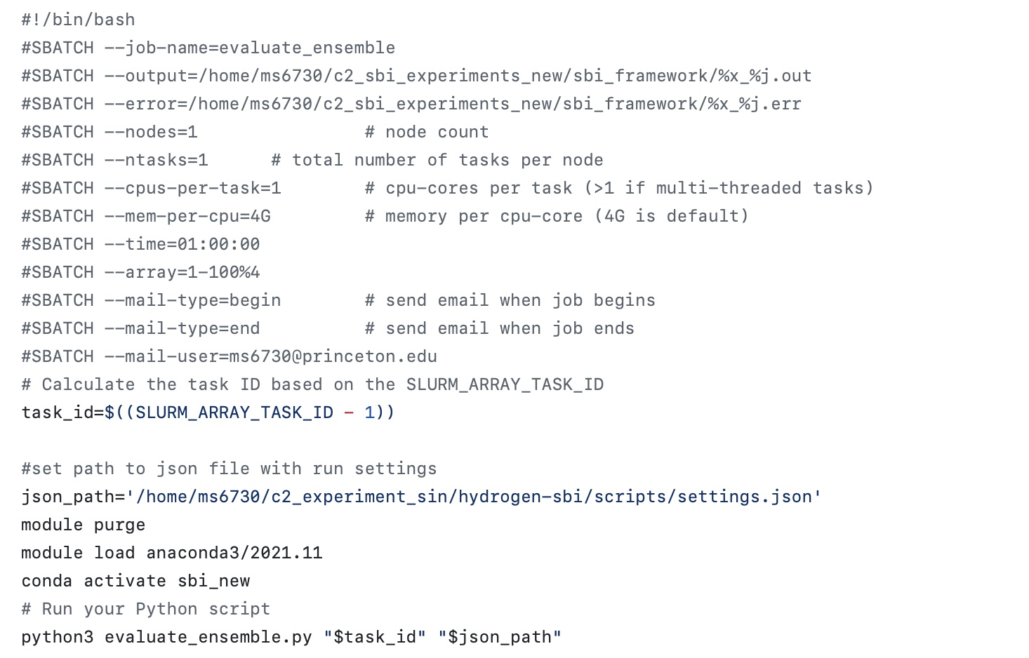
Modifications made for `evaluate_ensemble.sh`

Slide 14
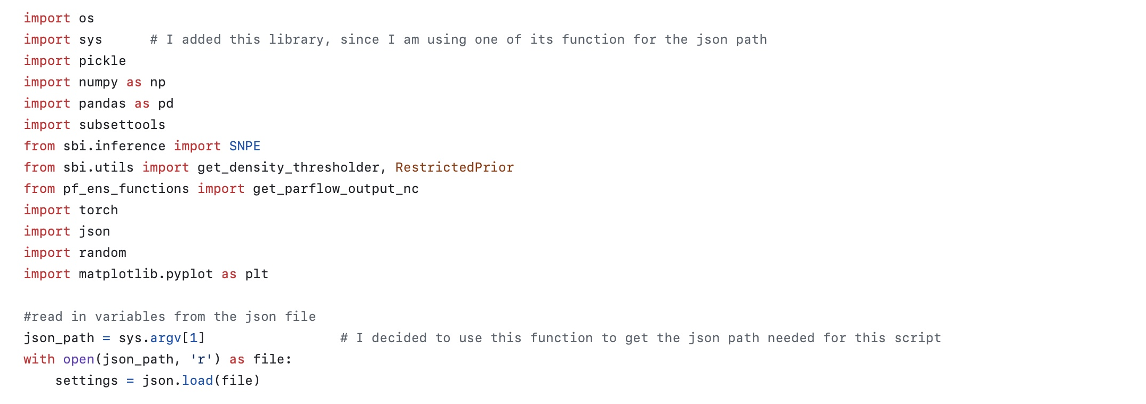
Modifications made for `evaluate_ensemble.py`

Slide 15
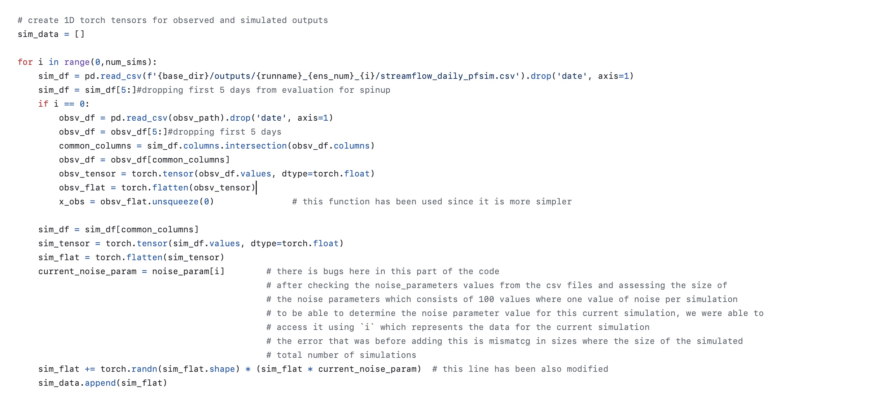
Modifications done to `evaluate_ensemble.py`

Slide 16
Github Repository
git@github.com:ms6730/Updated-Version-SBI-.git
https://github.com/ms6730/Updated-Version-SBI-.git

Slide 17
Github repository
The GitHub repository contains a README.md file that outlines all the necessary steps to run the scripts and train the model. Additionally, it documents the modifications made to the scripts.

Slide 18
Simulation Based Inference

Slide 19
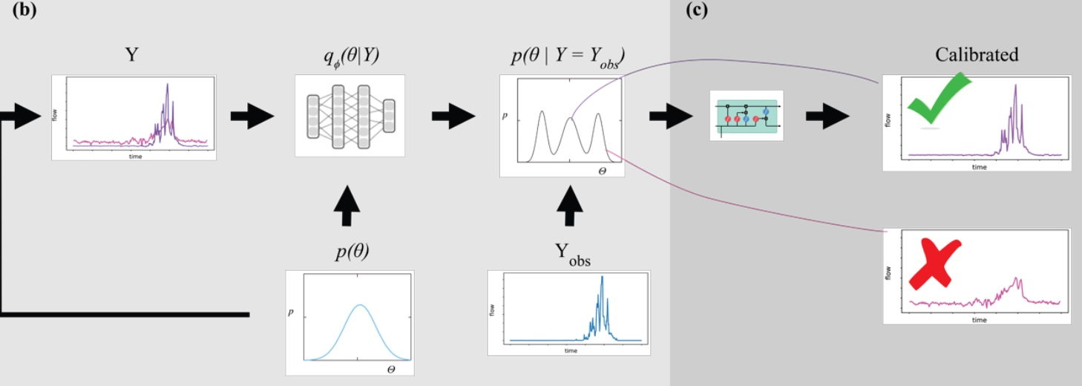
Simulation Based Inference
Validation

Slide 20
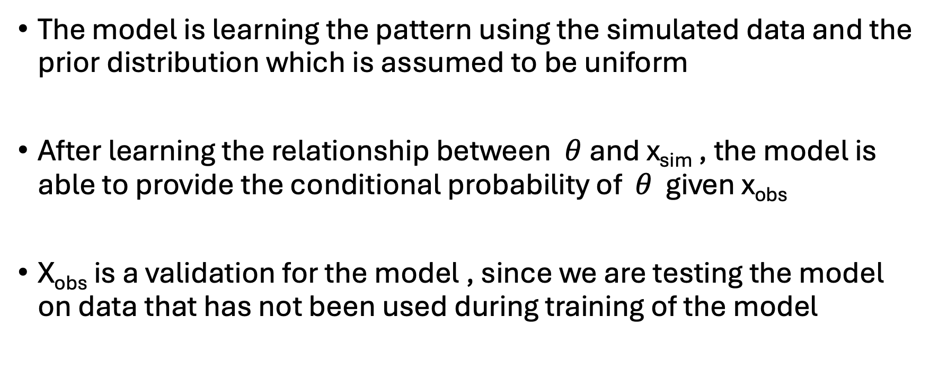
Validation : Observed data
The model is learning the pattern using the simulated data and the prior distribution which is assumed to be uniform
After learning the relationship between $θ$and x_{sim} , the model is able to provide the conditional probability of $θ$ given x_{obs}
X_{obs} is a validation for the model , since we are testing the model on data that has not been used during training of the model

Slide 21
Results

Slide 22
Simulated vs Observed data

Slide 23
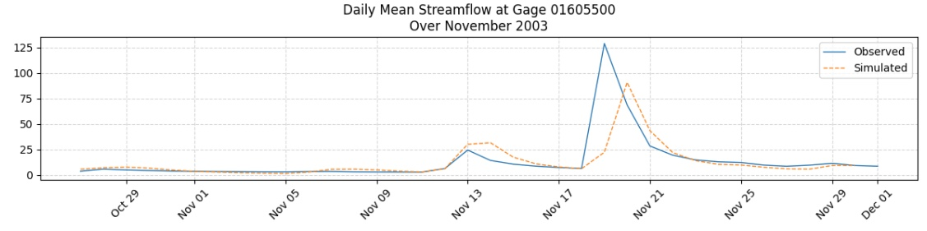
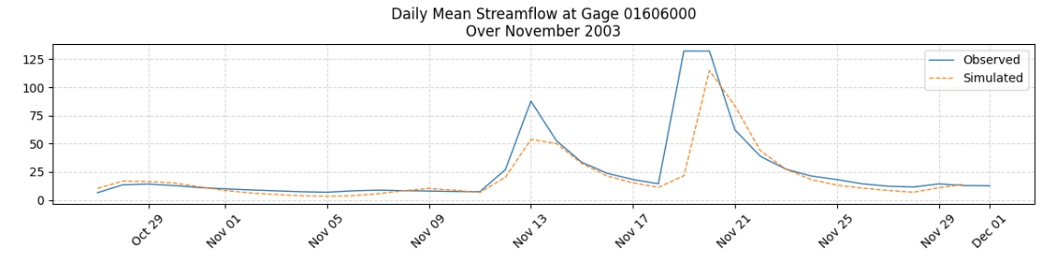
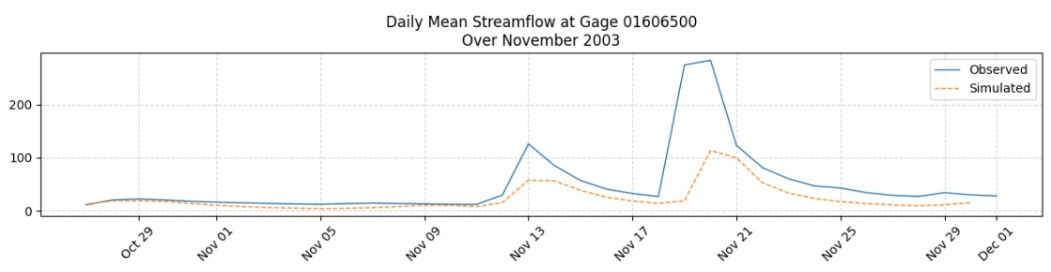

Slide 24
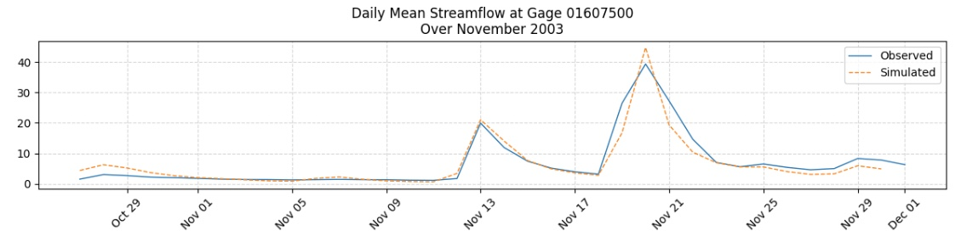
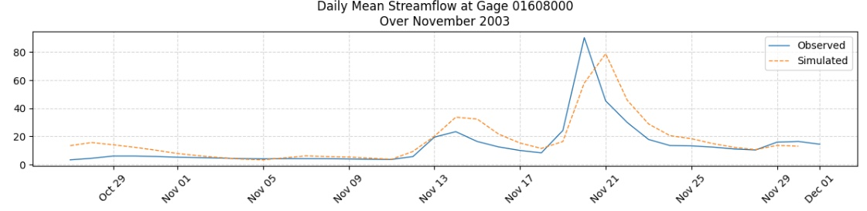
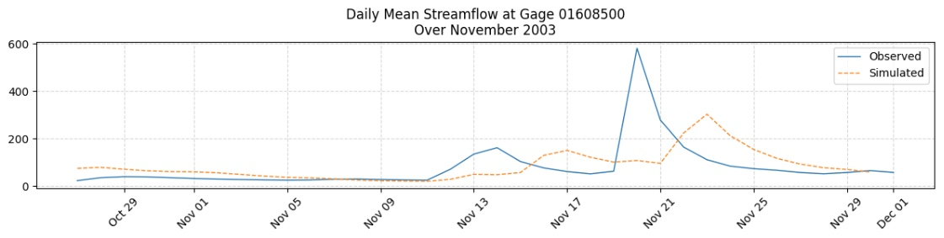

Slide 25
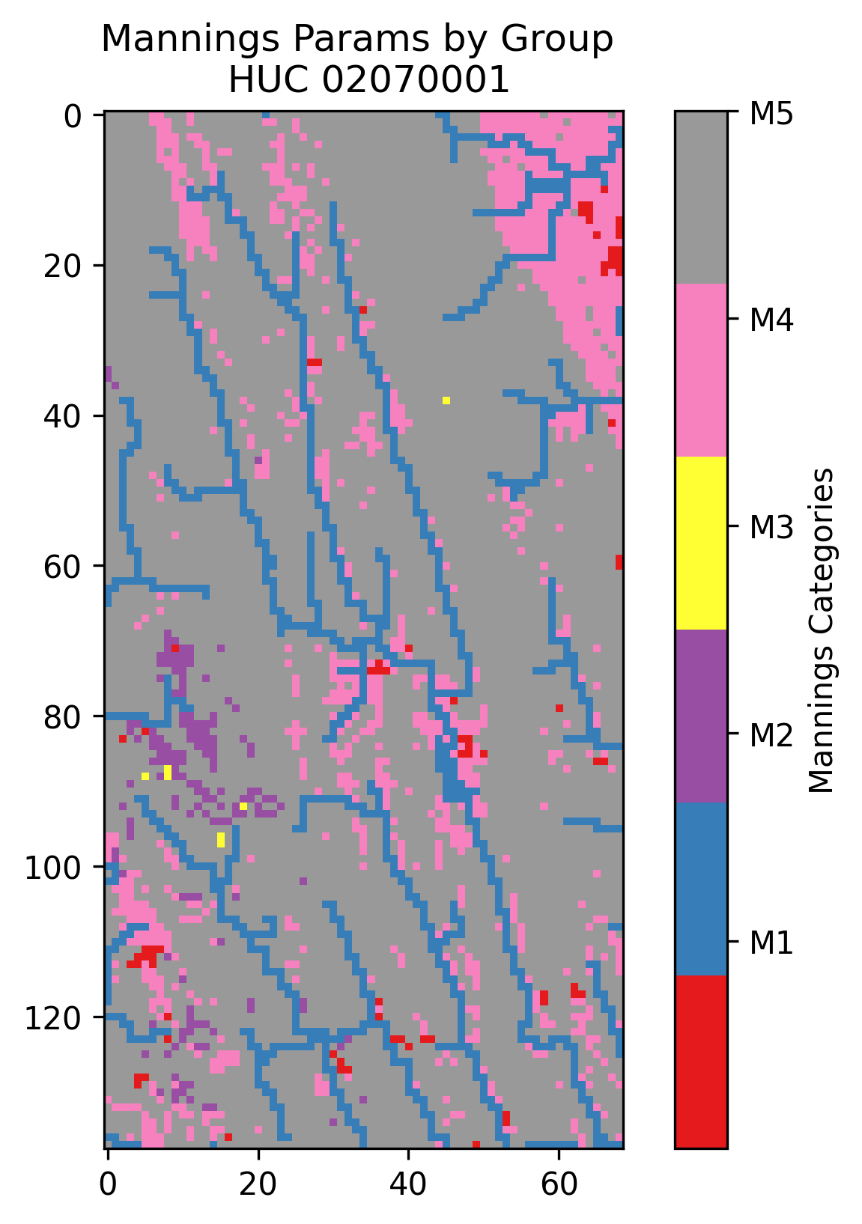
HUC : 02070001

Slide 26
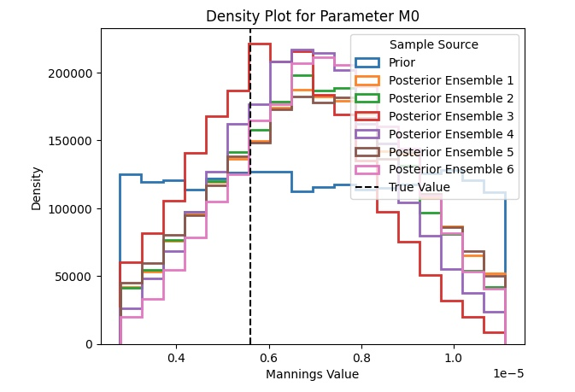
Density Plot for M₀

Slide 27
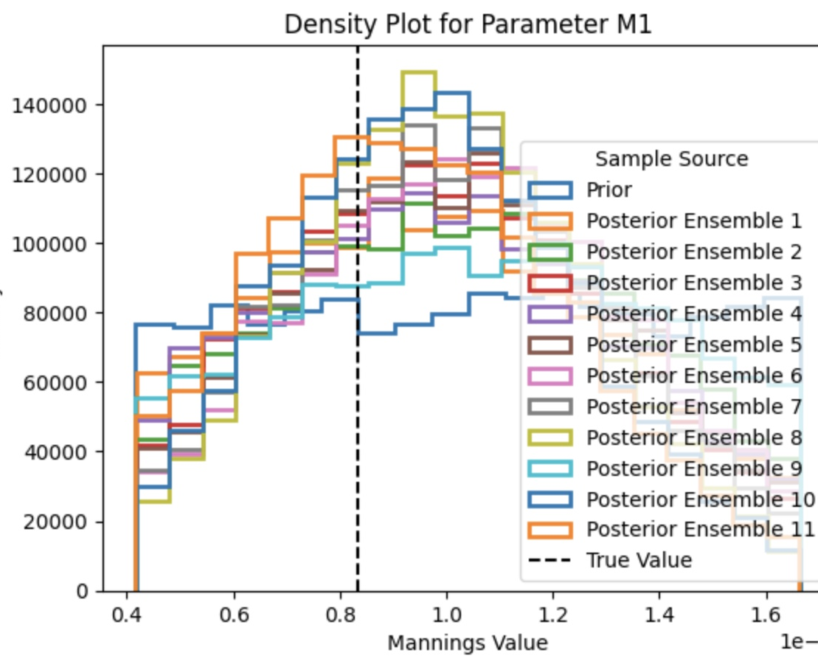
Density plot for M₁

Slide 28
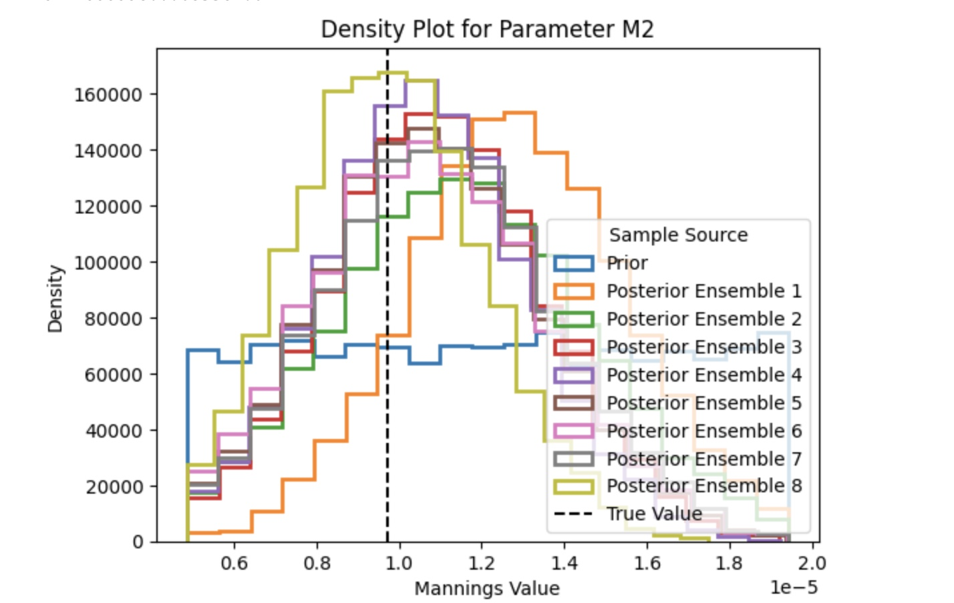
Density plot for M₂

Slide 29
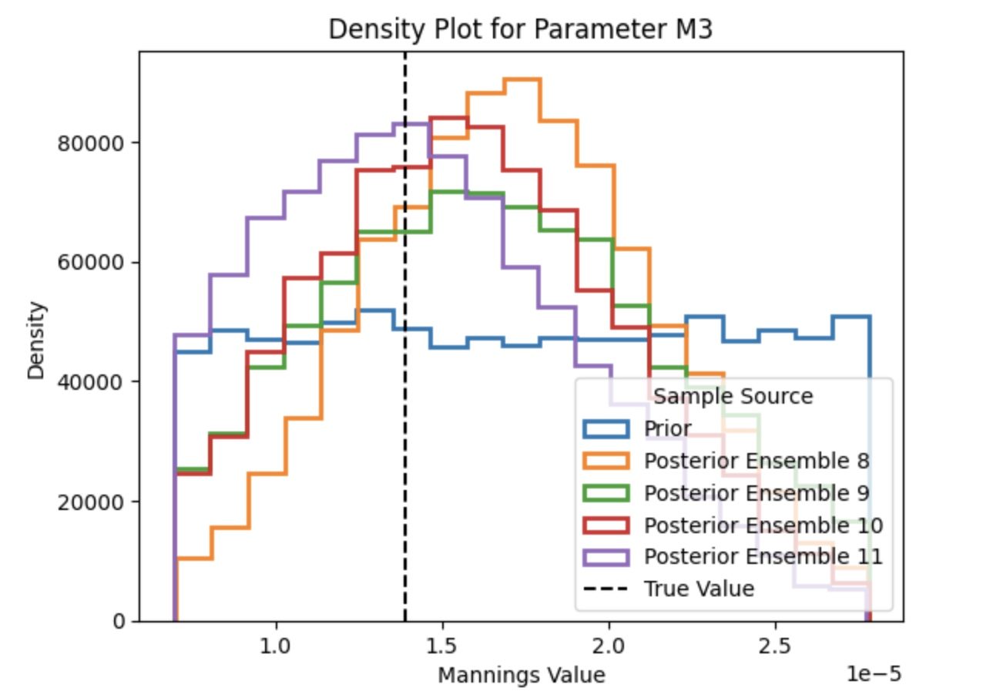
Density plot for M₃

Slide 30
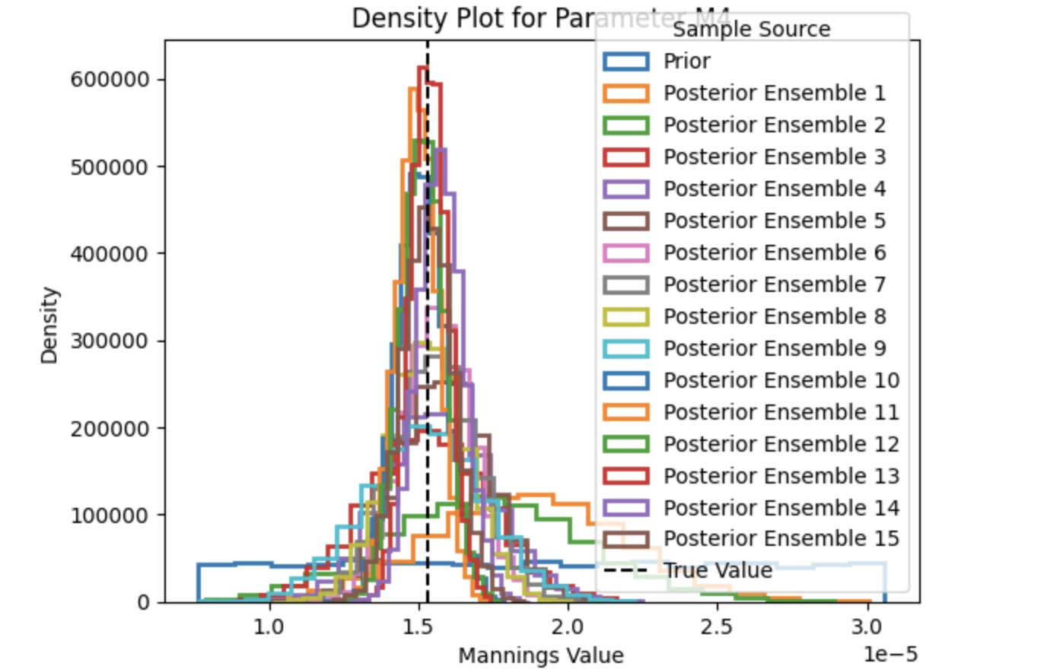
Density plot for M₄

Slide 31
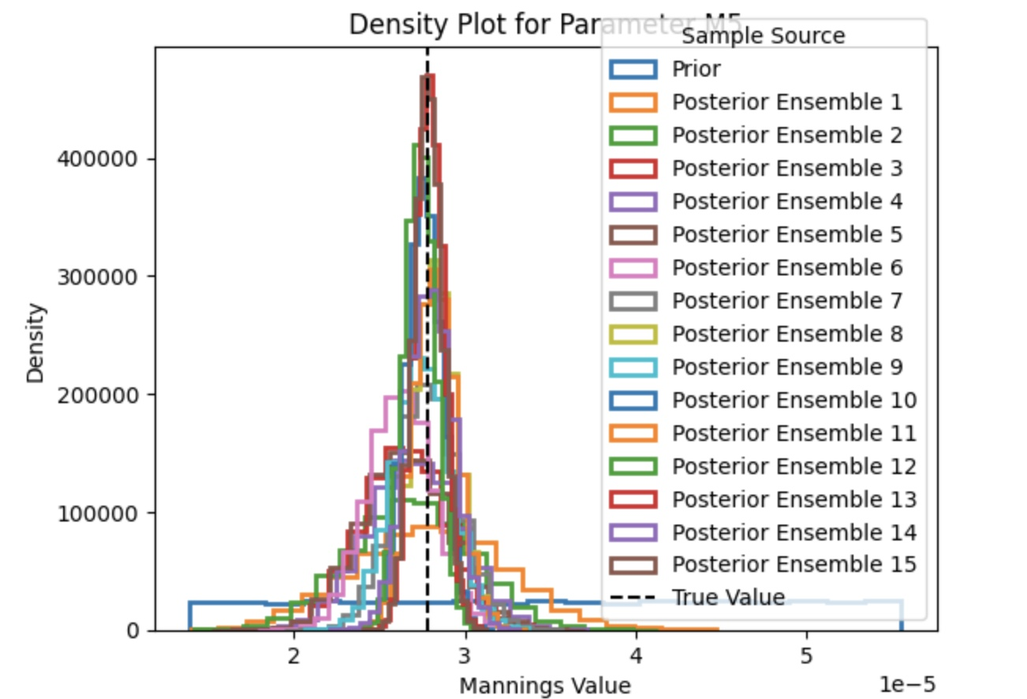
Density plot for M₅

Slide 32
Gage : 01605500

Slide 33
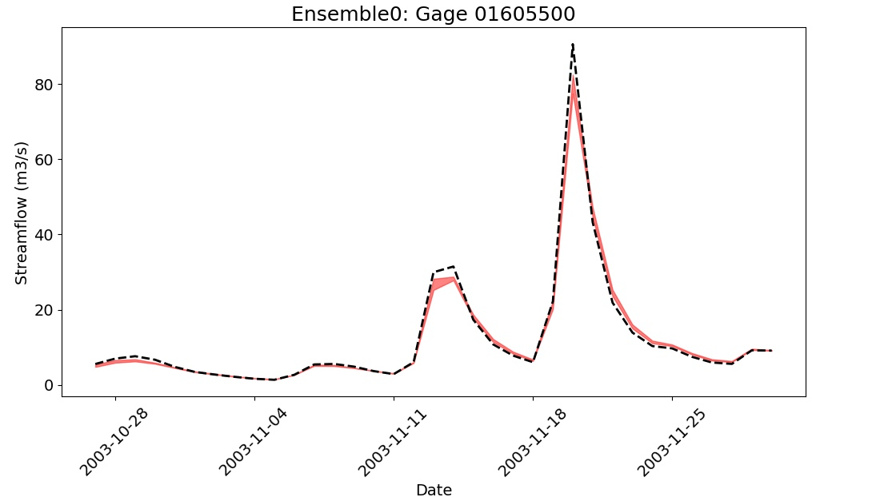
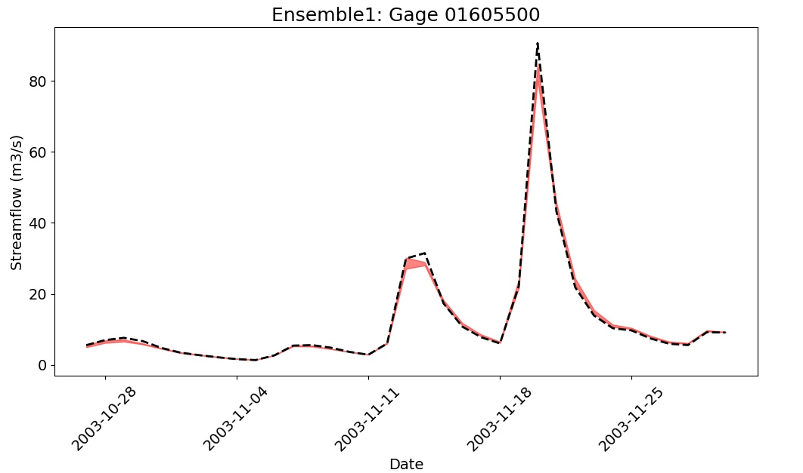
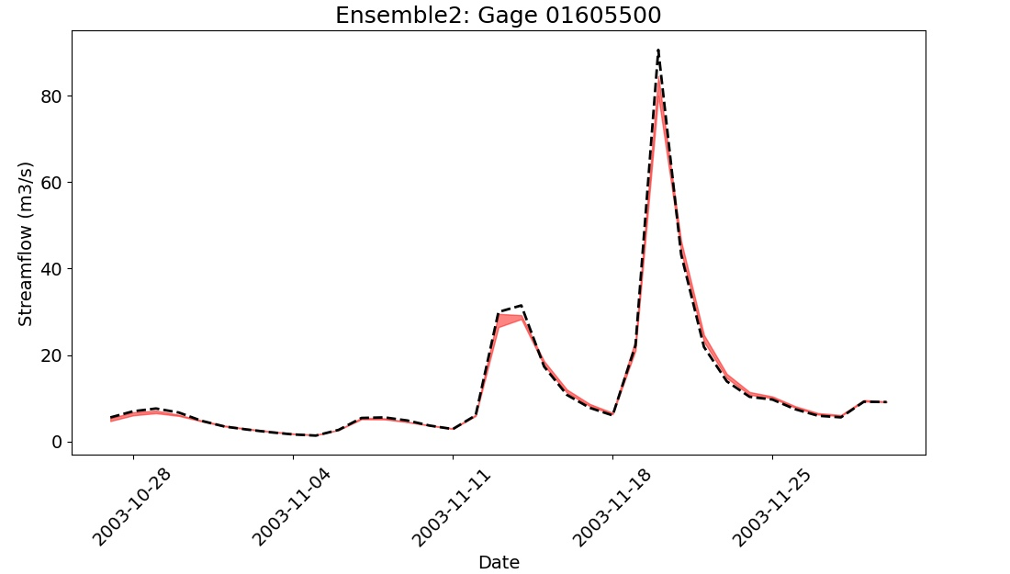

Slide 34
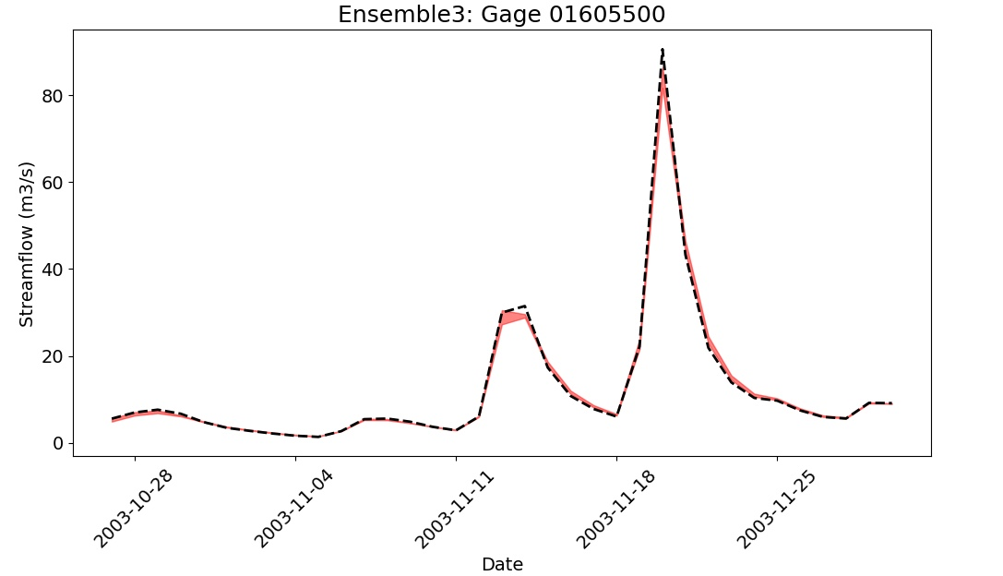
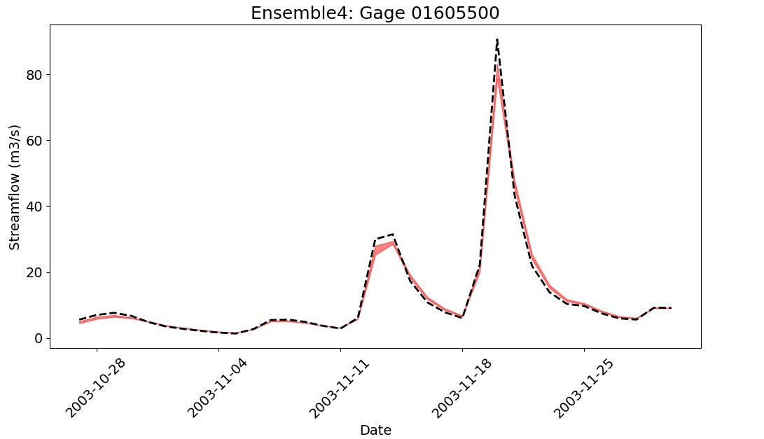

Slide 35
Gage: 01606000

Slide 36
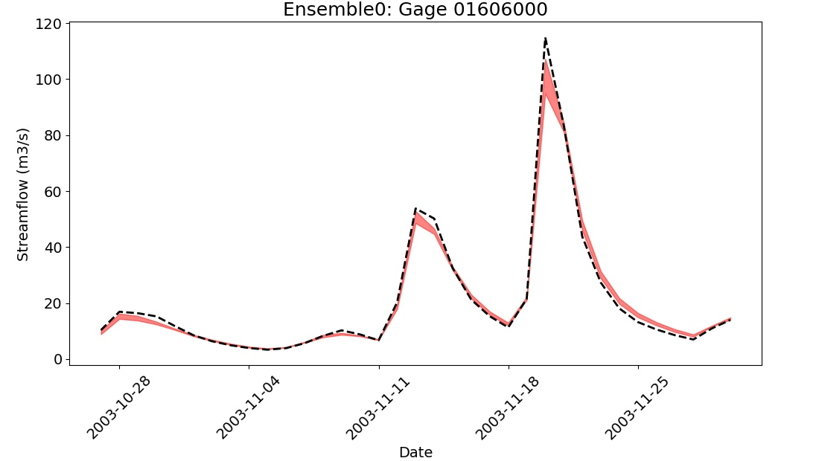
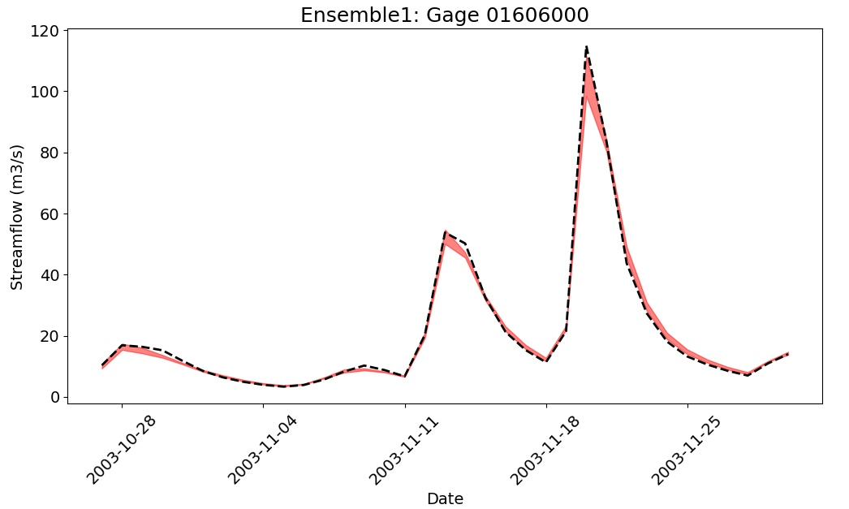

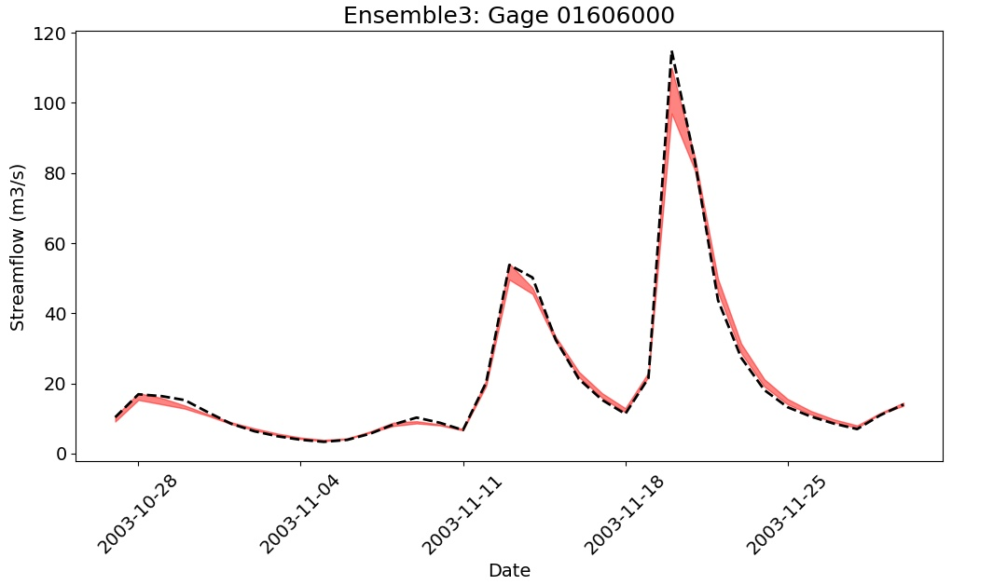

Slide 37
Gage: 01607500

Slide 38
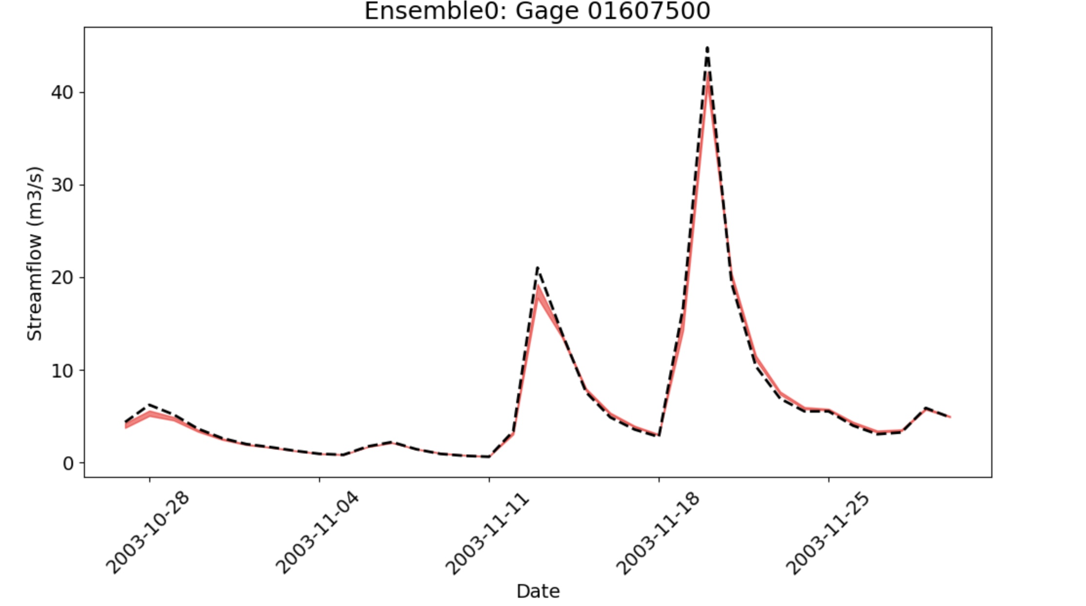
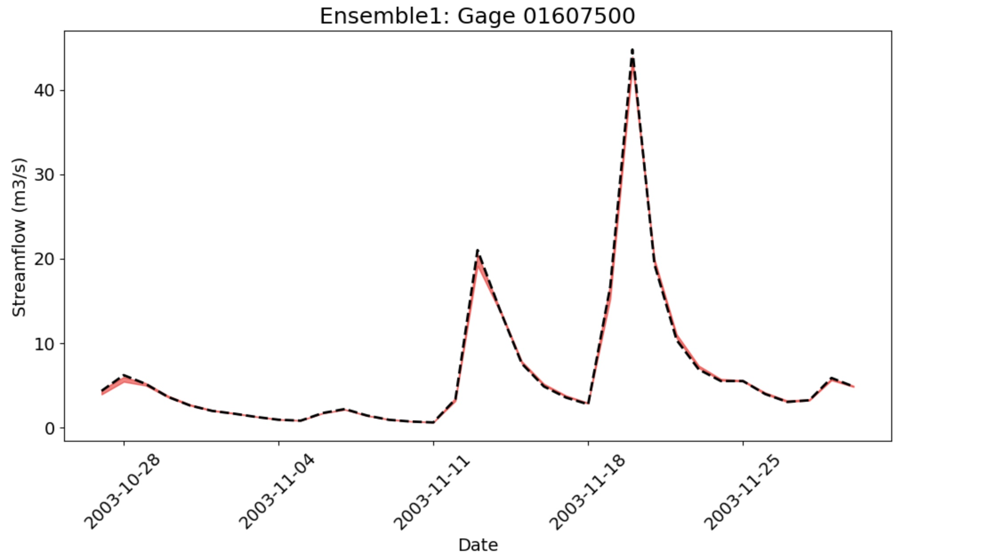
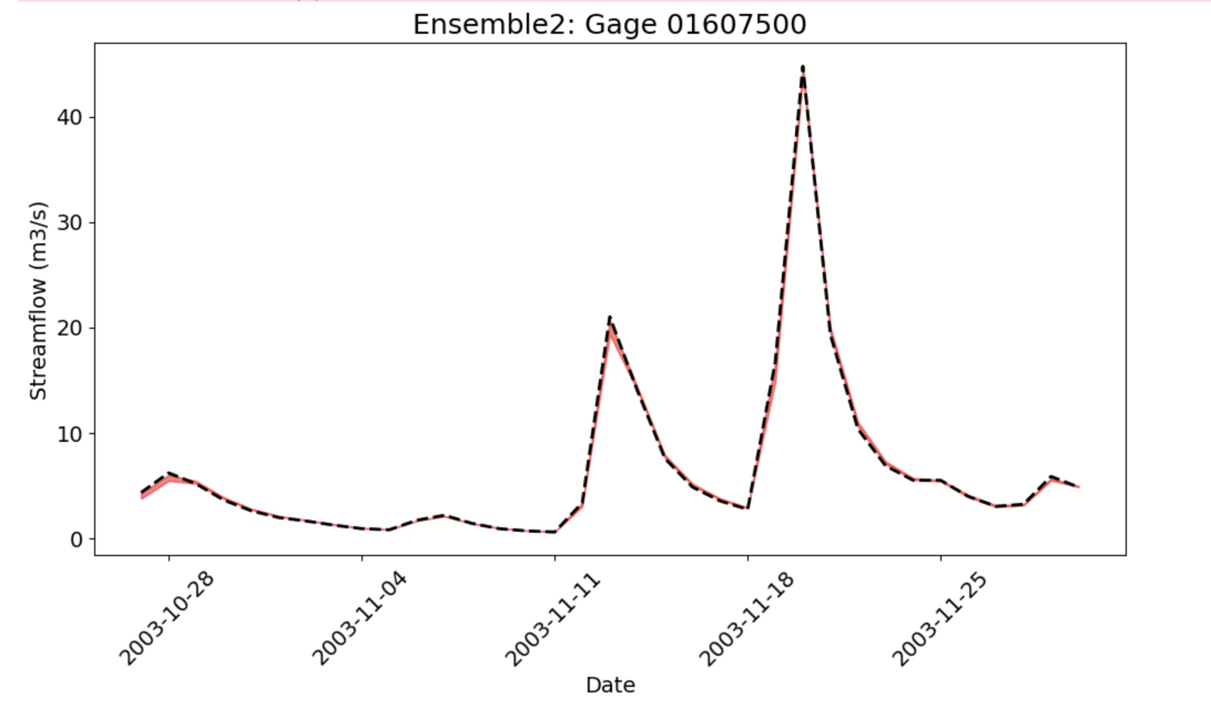
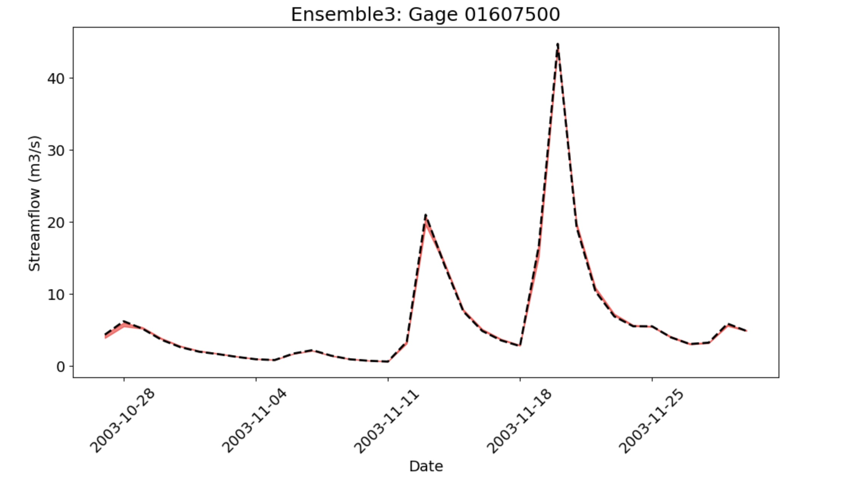

Slide 39
Percentage of error Validation Test

Slide 40
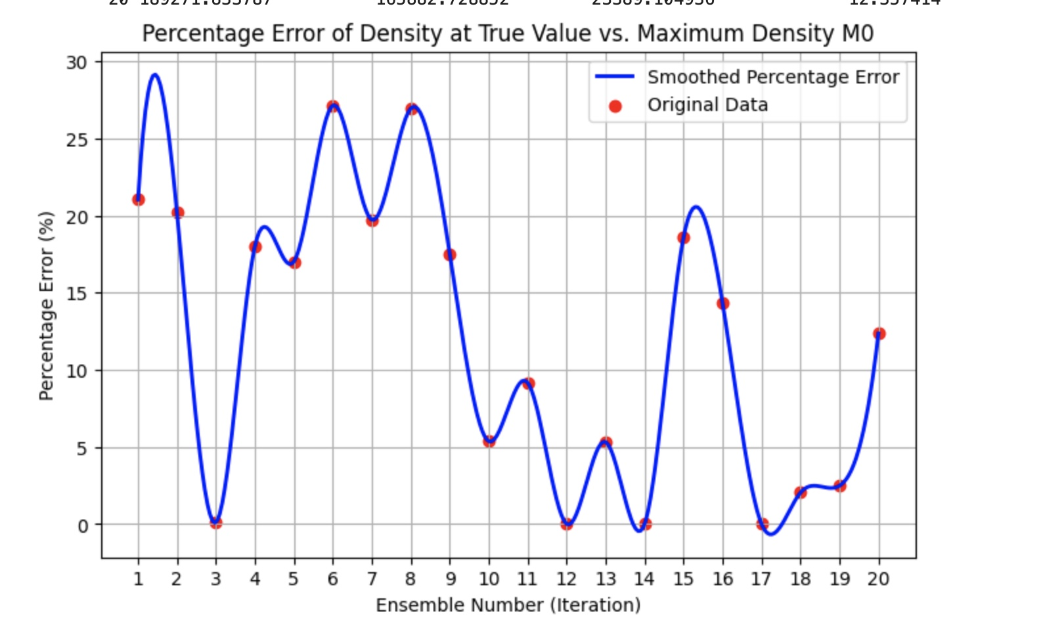
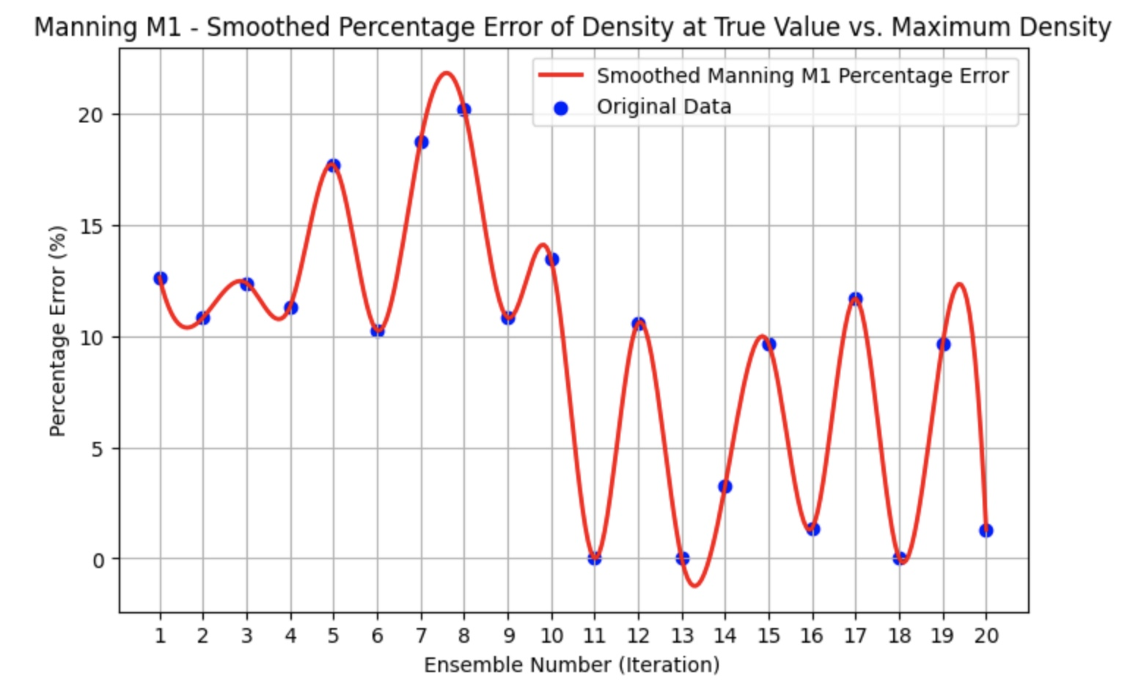
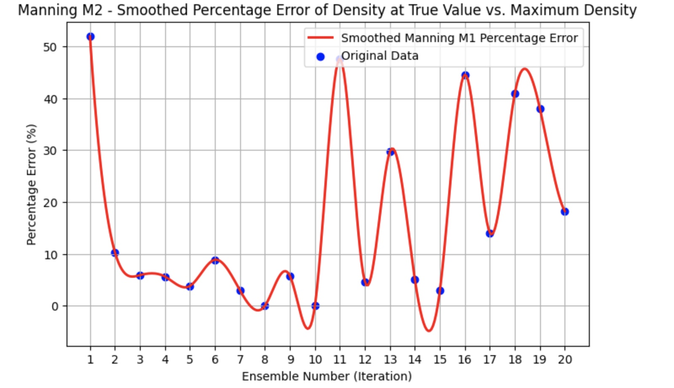
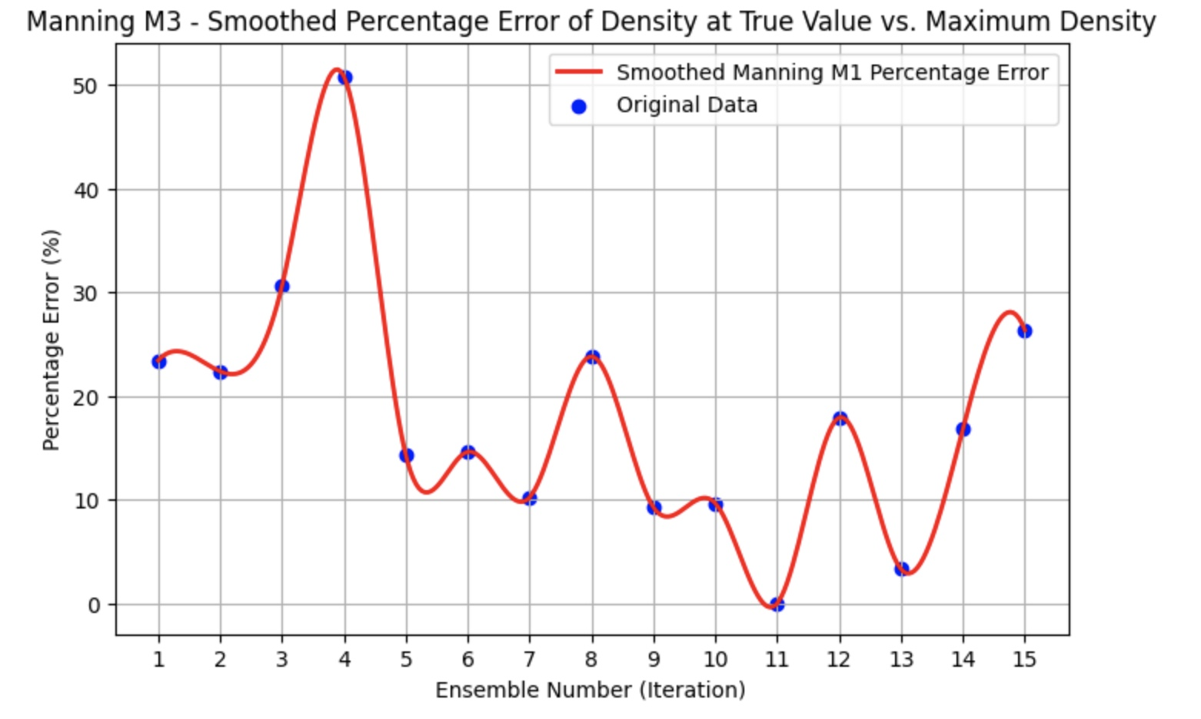

Slide 41
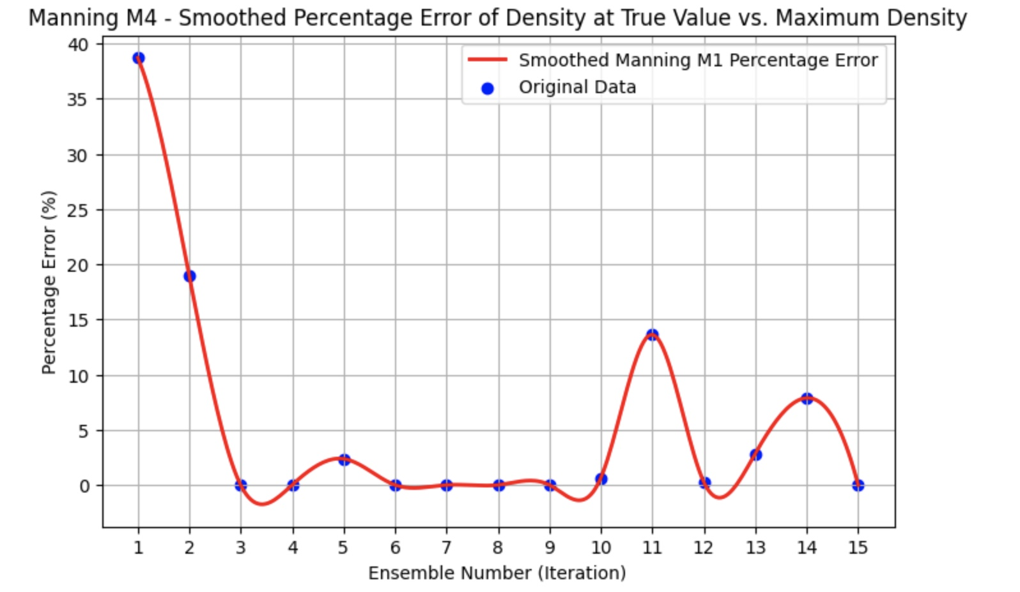
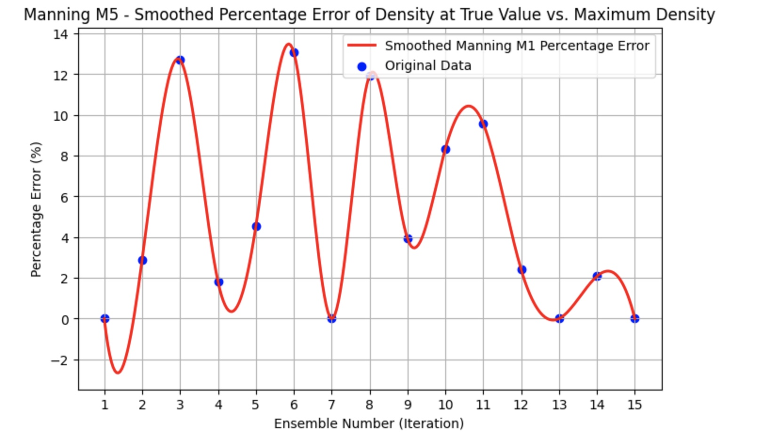

Slide 42
Upcoming
1. How the neural network function to get new posterior ?
2. What loss function does the neural network use ?
3. Conduct sensitivity analysis for the learning rate and the number of simulations ?
5. The problem that is related to the pf-clm single column ?

Slide 43
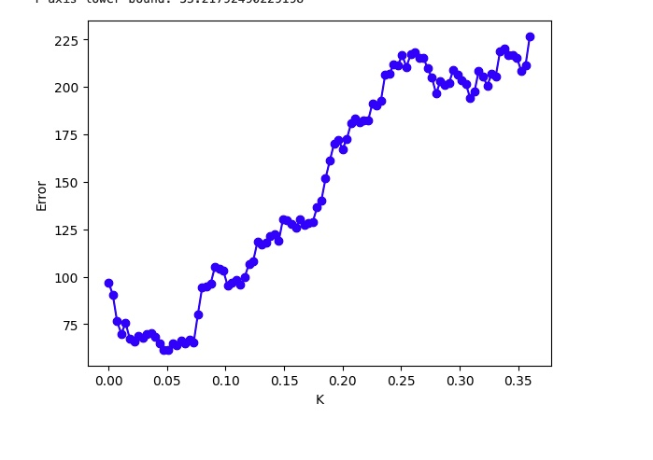

Slide 44
Selection of courses
APC 523 / CEE 423
SML 505
CEE 509

Slide 45
What are the results that I do upload on SBI _prototype?

